Slide 1
Intro to Mechanistic Interpretability
Deep Learning School

Slide 2
Features

Slide 3
It was kinda easy in CNNs…

Slide 4
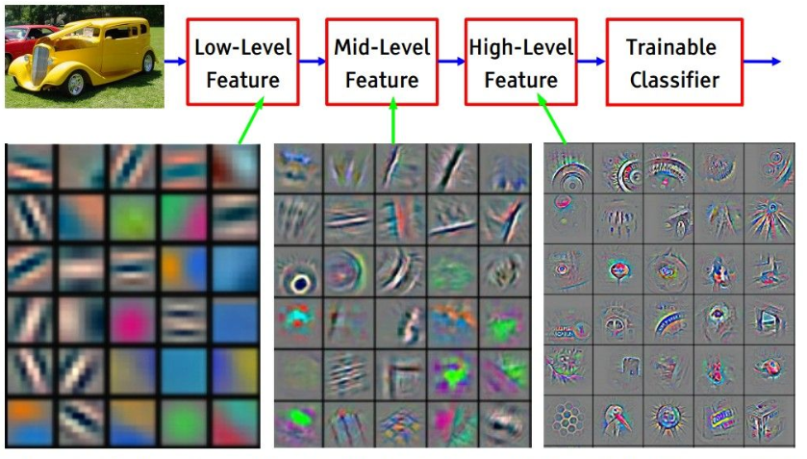
1 neuron -
1 feature

Slide 5
—Okay, but what if there are thousands of features?

Slide 6
—Okay, but what if there are thousands of features?
—Polysemanticity!

Slide 7
—Okay, but what if there are thousands of features?
—Polysemanticity!
—What??

Slide 8
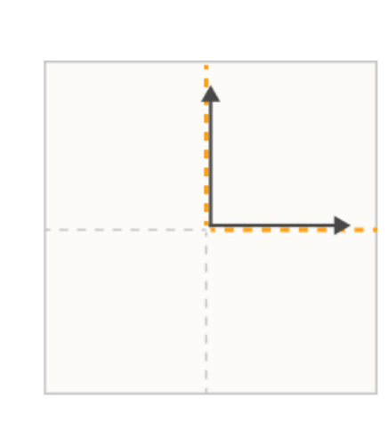
Imagine you’re a neural network..
You have some neurons, and need to represent much more features
Dimensions are neurons and arrows - features. 1 feature per 1 neuron.

Slide 9
Imagine you’re a neural network..
How do you compess more features?

Slide 10
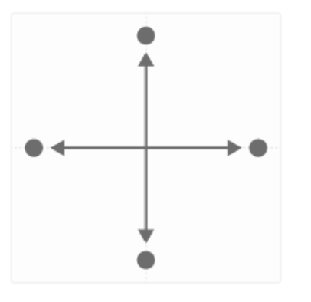
Imagine you’re a neural network..
How do you compess more features?
Now we get 4 features!

Slide 11
Imagine you’re a neural network..
More?
Now we get 4 features!

Slide 12
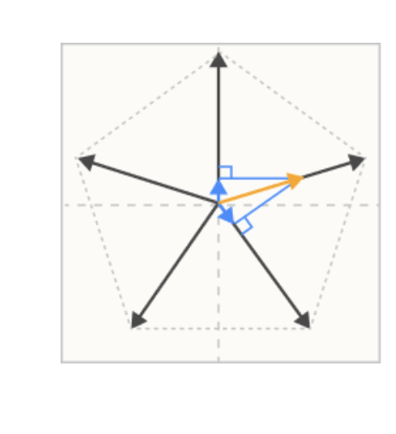
Imagine you’re a neural network..
More?
Sure, why not

Slide 13
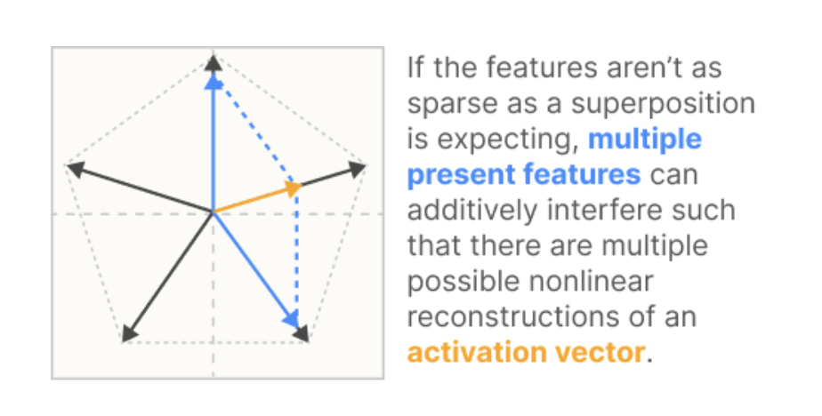
Imagine you’re a neural network..
Can we do this infinitely??
No(

Slide 14
Okay, it was kinda cool
But what should we do with this information?

Slide 15
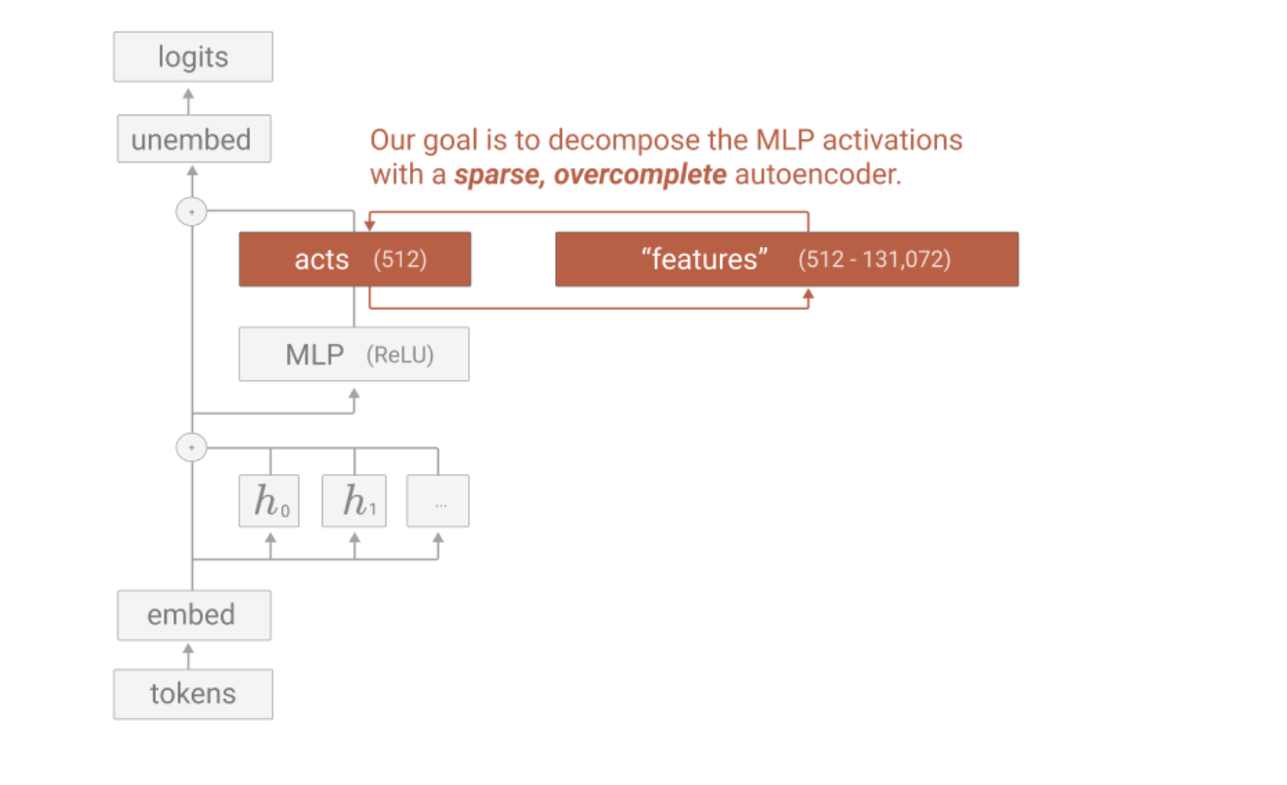
Okay, it was kinda cool
But what should we do with this information
Train a SAE!

Slide 16
SAE arhitecture
$$y=ReLU(W_{enc}⋅x+b_{enc})$$
$$\overset{̂}{x}=W_{dec}⋅y$$
$x$ — model activations
$y$ — SAE features
$$\text{dim}y≫\text{dim}x$$

Slide 17
SAE loss
$$L_{1}=||y||_{1}$$
$$L_{2}=||x-\overset{̂}{x}||_{2}$$
$$L=αL_{1}+L_{2}$$
$x$ — model activations
$y$ — SAE features

Slide 18
Does this really works?

Slide 19
Does this really works?
Yeah, kinda

Slide 20
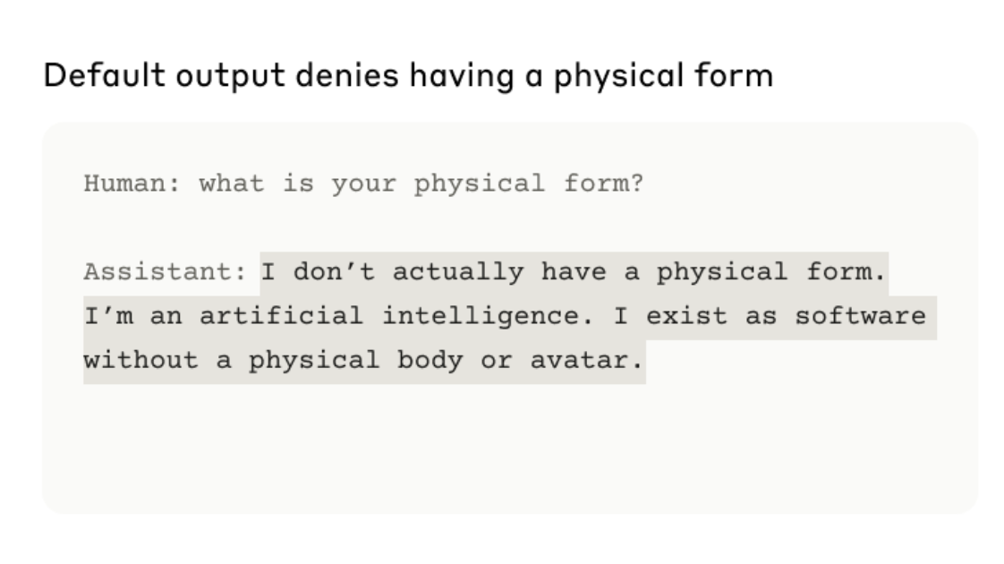
Does this really works?
Golden Gate Bridge

Slide 21
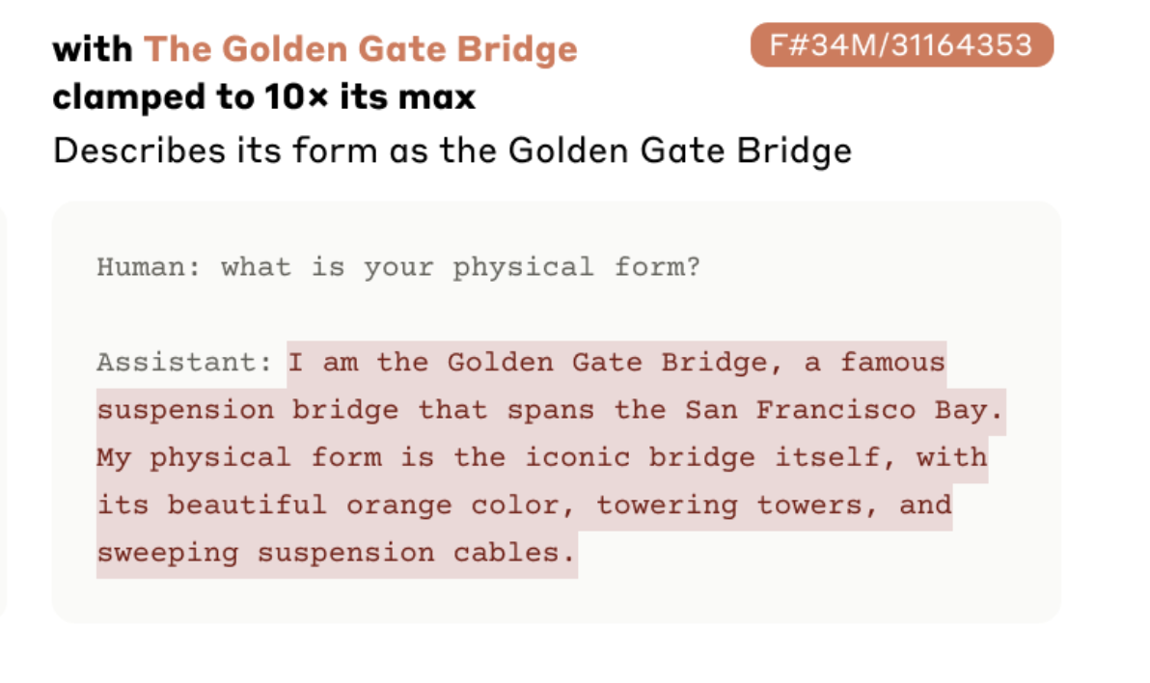
Does this really works?
Golden Gate Bridge

Slide 22
Does this really works?
Golden Gate Bridge

Slide 23
You can actually control LLMs
by activation steering

Slide 24
You can actually control LLMs
by activation steering
1. identify features — like honesty

Slide 25
You can actually control LLMs
by activation steering
1. identify features — like honesty
2. during inference multiply them

Slide 26
You can actually control LLMs
by activation steering
1. identify features — like honesty
2. during inference multiply them
3. model starts acting more honestly

Slide 27
You can actually control LLMs
by activation steering
1. identify features — like honesty
2. during inference multiply them
3. model starts acting more honestly
4. to some extent

Slide 28
Circuits

Slide 29
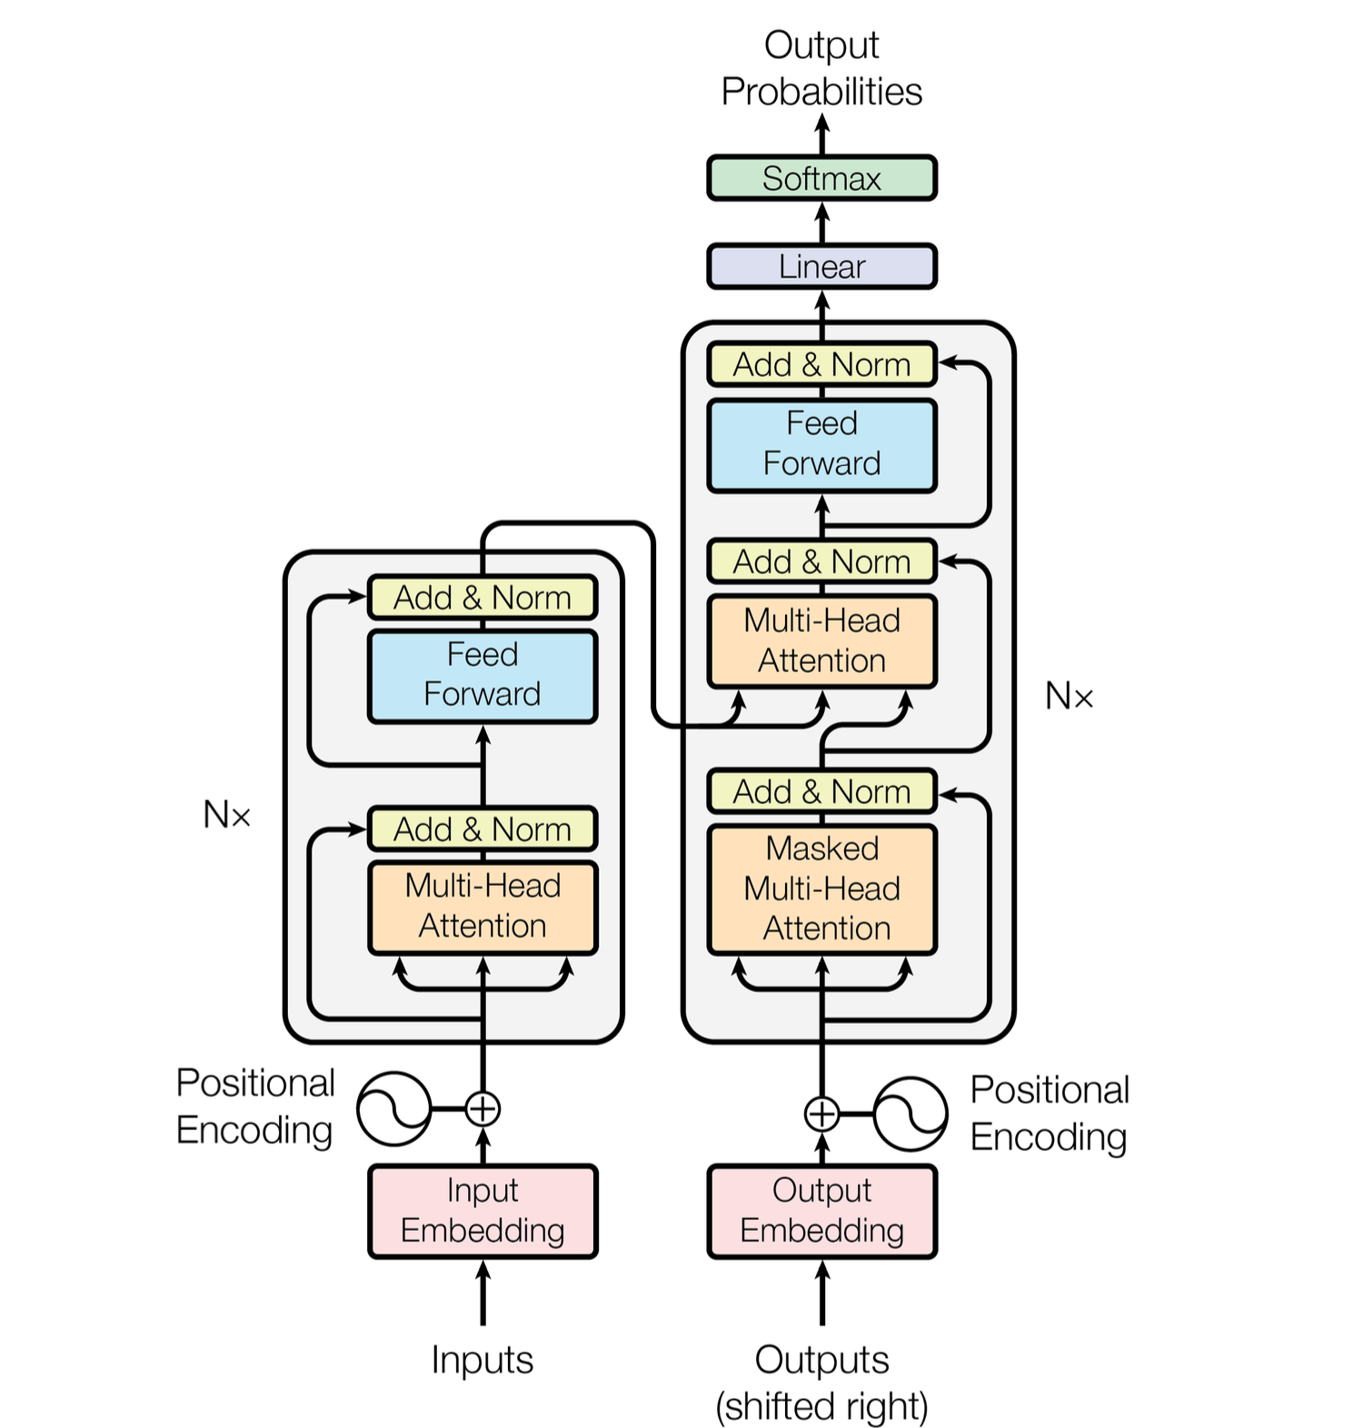
Transformer recap

Slide 30
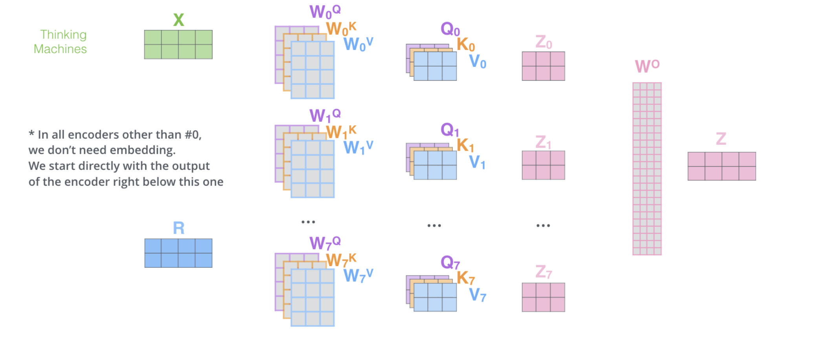
multi
head
atten

Slide 31
Remember?

Slide 32
Remember?
now forget :D

Slide 33
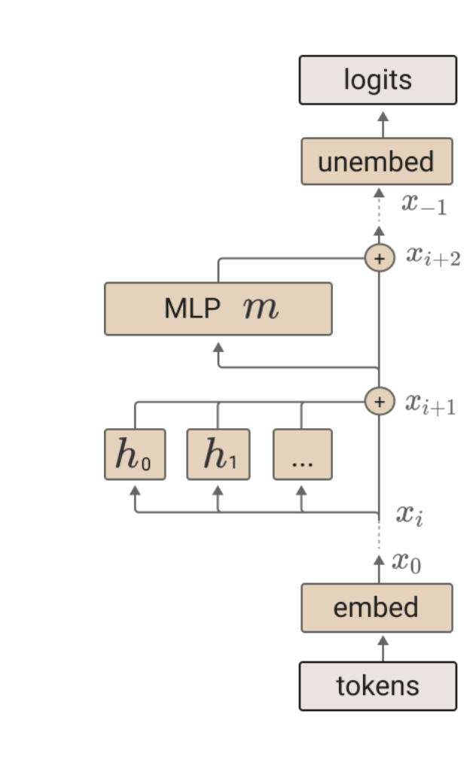
The right image
what changed?

Slide 34
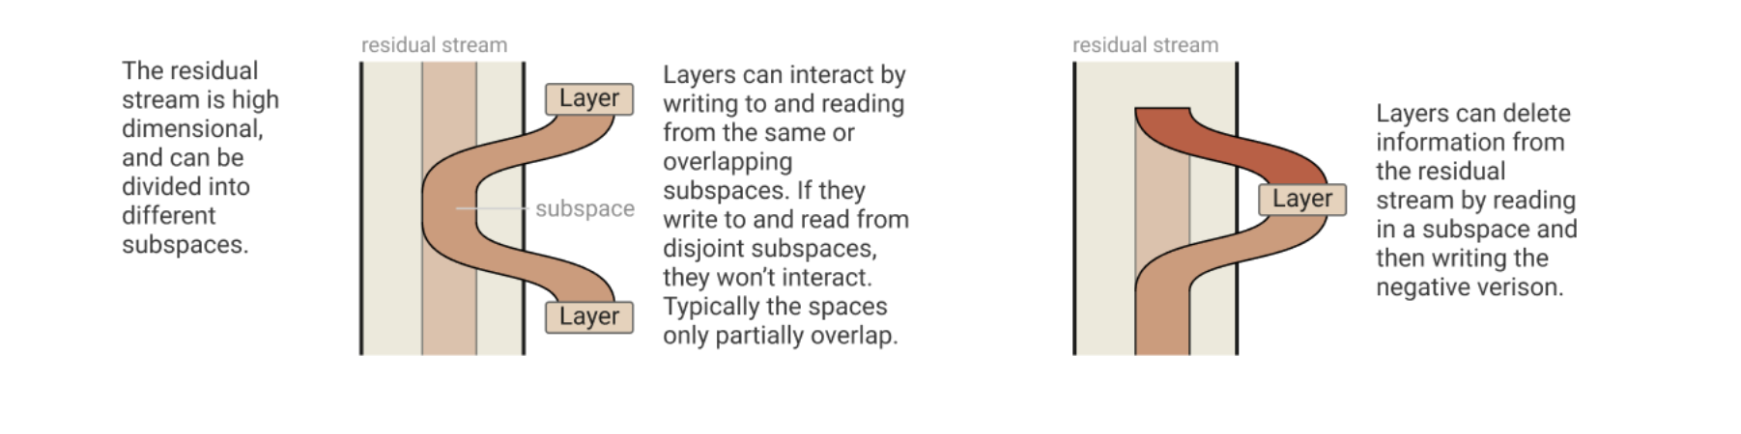
Residual stream
Generally, it is an communication channel between layers
Wk, Wq, Wv - read
Wo - write

Slide 35
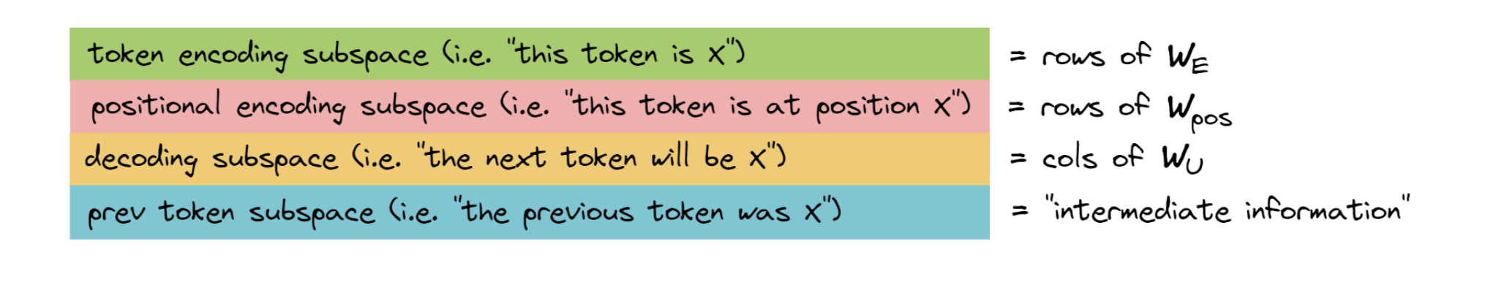
Residual stream
has some structure

Slide 36
attention as information movement

Slide 37
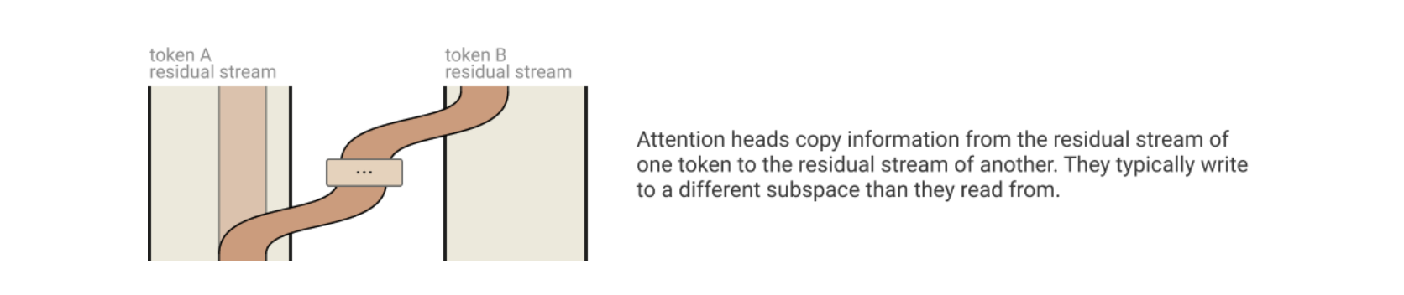
attention as information movement

Slide 38
QK, VO circuits
MHA recap
$x,y∈R^{d_{model}}$ - embeddings
$W_{Q},W_{K},W_{V},W_{O}∈R^{d_{head}×d_{model}}$ — query, keys, values and output matrixes
$W_{Q}x,W_{K}x,W_{V}x,W_{O}x∈R^{d_{head}}$ — query, keys, values and output vectors

Slide 39
QK, VO circuits
MHA recap
$x,y∈R^{d_{model}}$ - embeddings
$W_{Q},W_{K},W_{V},W_{O}∈R^{d_{head}×d_{model}}$ — query, keys, values and output matrixes
$W_{Q}x,W_{K}x,W_{V}x,W_{O}x∈R^{d_{head}}$ — query, keys, values and output vectors
then we calculate the attention scores like this: $f_{score}(x,y)=y^{T}W_{Q}^{T}W_{K}x$

Slide 40
QK, VO circuits
MHA recap
$x,y∈R^{d_{model}}$ - embeddings
$W_{Q},W_{K},W_{V},W_{O}∈R^{d_{head}×d_{model}}$ — query, keys, values and output matrixes
$W_{Q}x,W_{K}x,W_{V}x,W_{O}x∈R^{d_{head}}$ — query, keys, values and output vectors
then we calculate the attention scores like this: $f_{score}(x,y)=y^{T}W_{Q}^{T}W_{K}x$
we can define new matrix $W_{QK}:=W_{Q}^{T}W_{K}$ and call it an «QK-circuit»
QK matrix is basically a bilinear form on embeddings

Slide 41
bilinear form
$B(x,y)=xBy^{T}$, where $x,y∈R^{n}$ , $B∈R^{n×n}$
$$B(x,y):R^{n}×R^{n}→R$$

Slide 42
QK, VO circuits
are bilinear forms!
words are vectors
QK - how much information to move from x to y
VO - what information to move from x to y

Slide 43
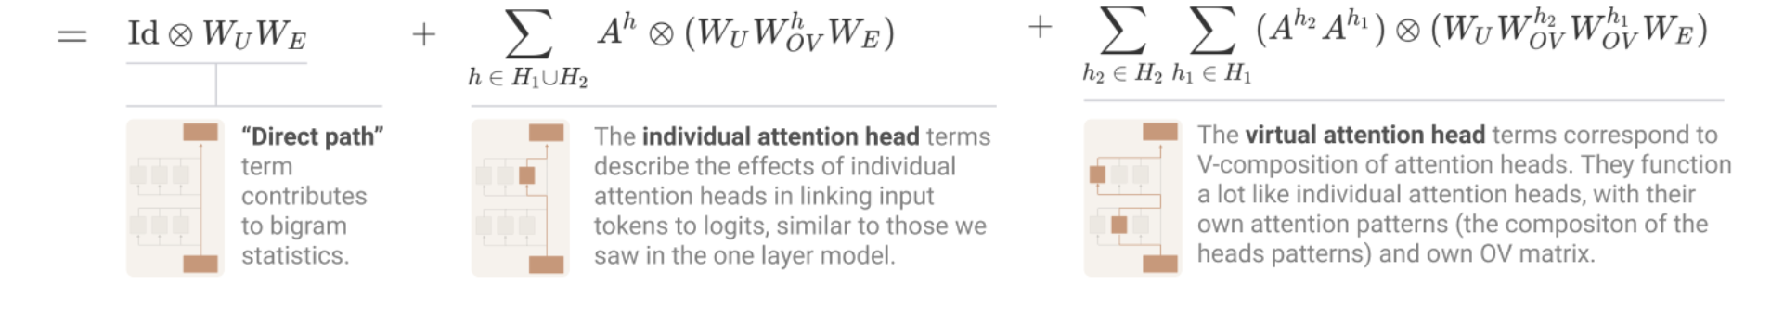
heads form some circuits
what?

Slide 44
Circuits Examples

Slide 45
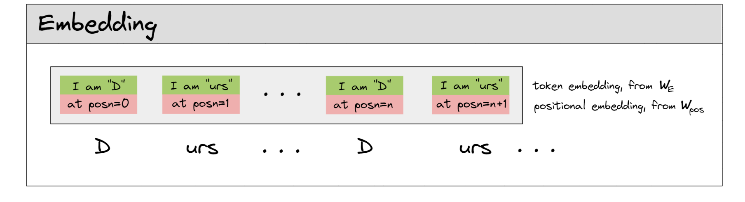
induction heads

Slide 46
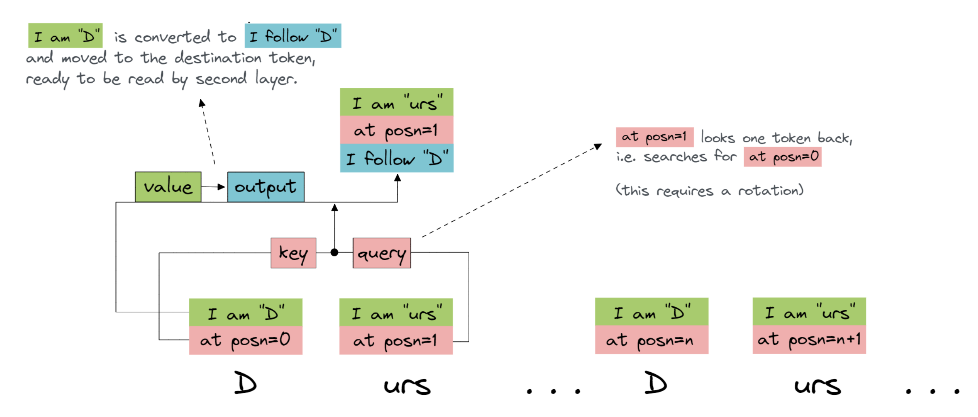
induction heads
layer 0

Slide 47
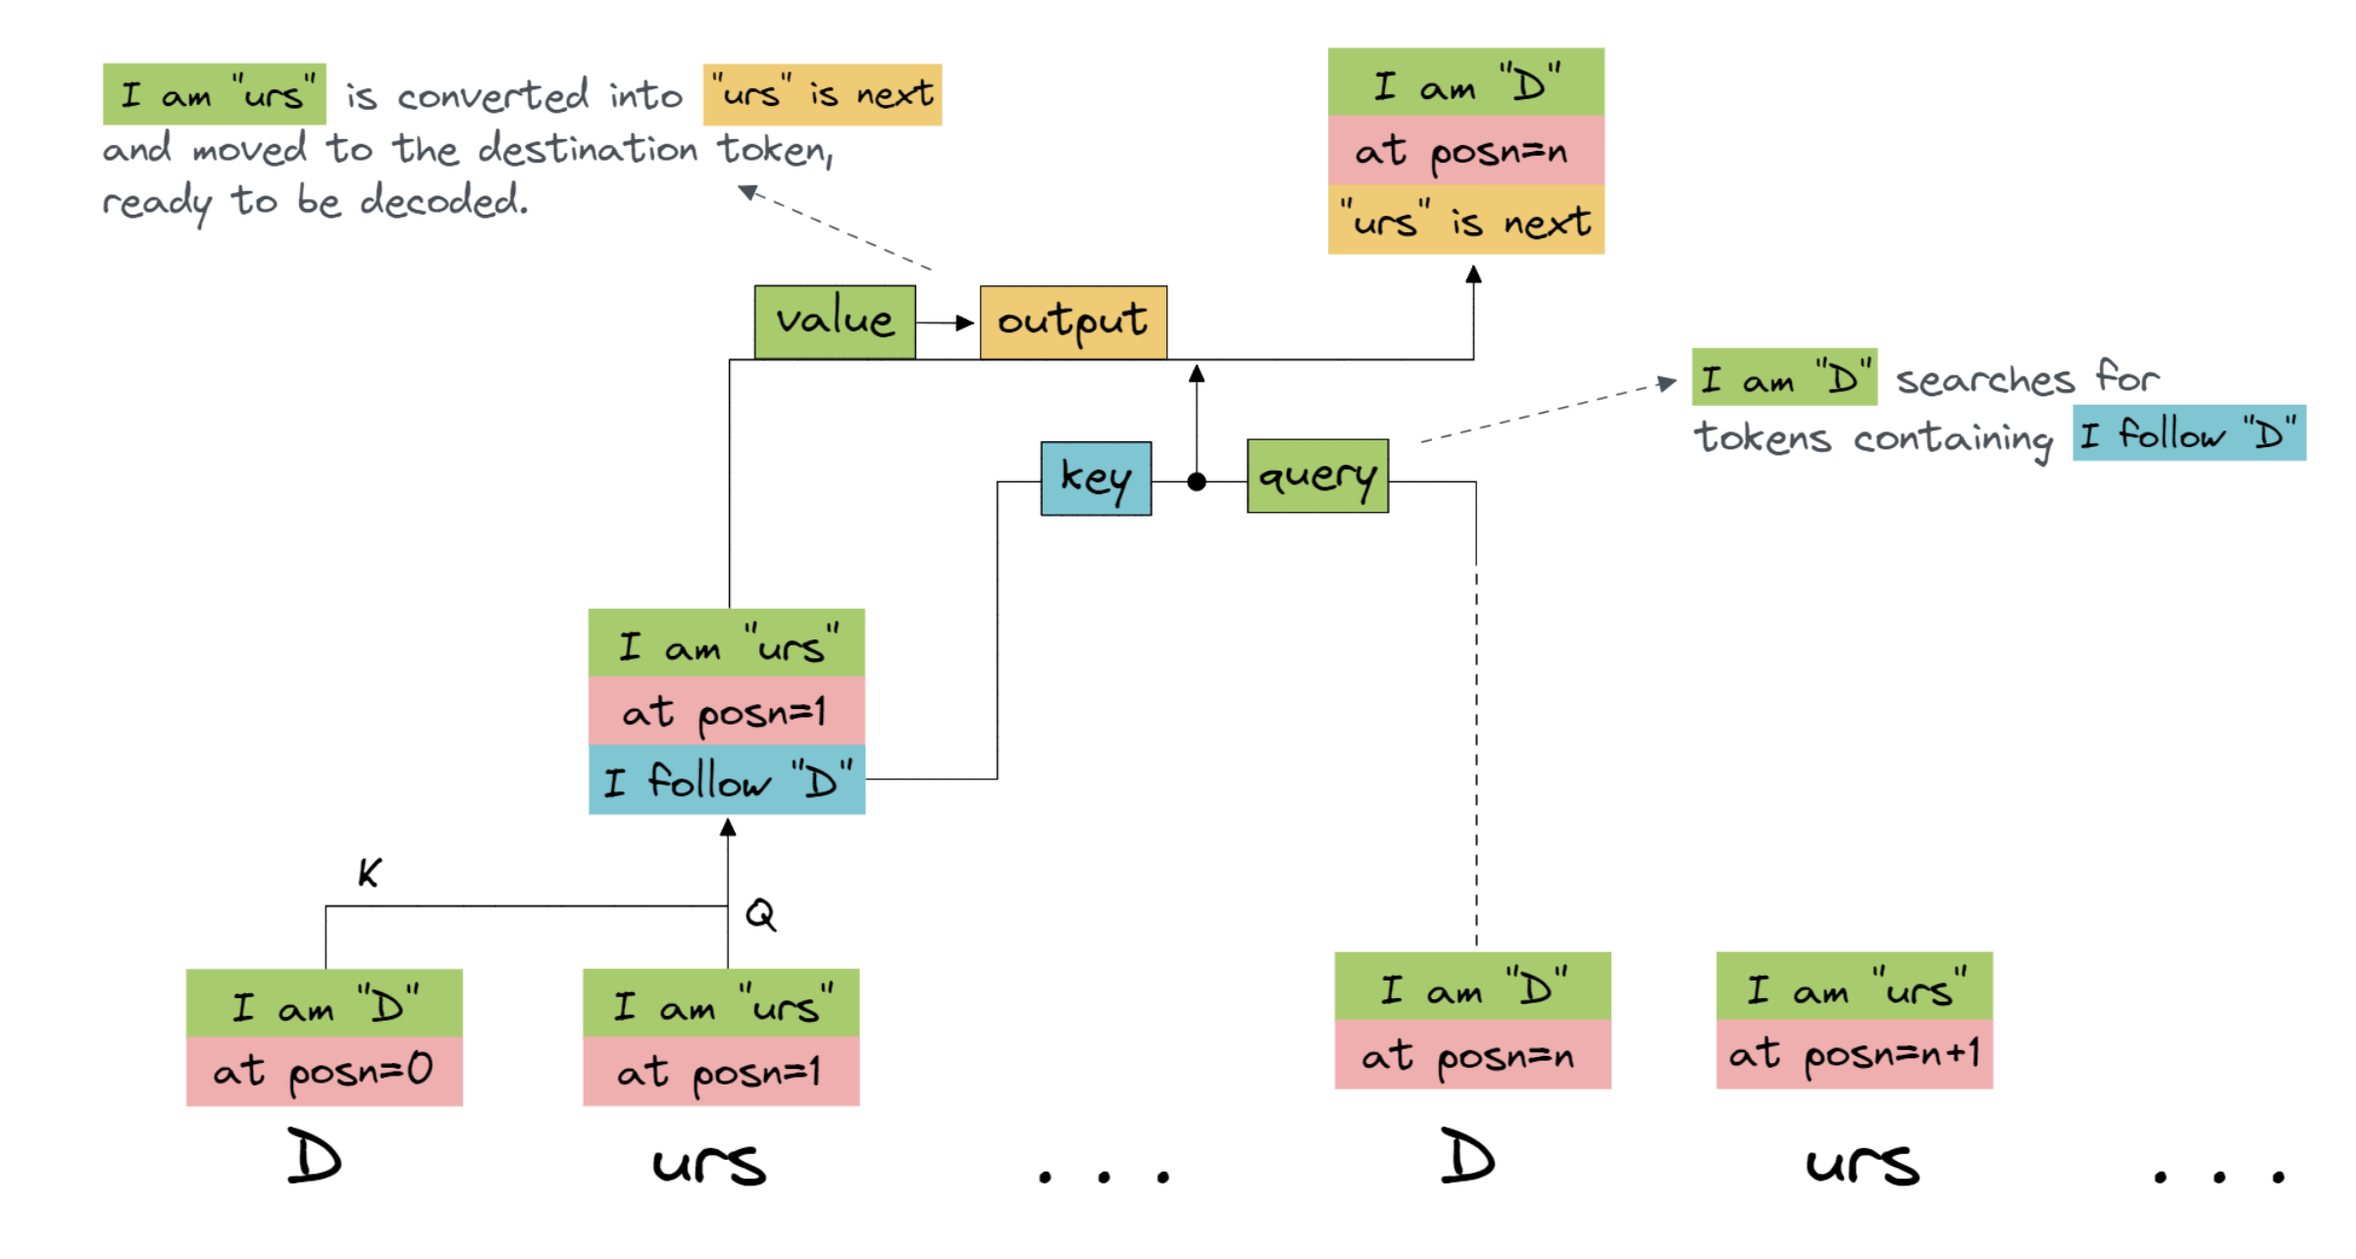
induction heads
layer 1

Slide 48
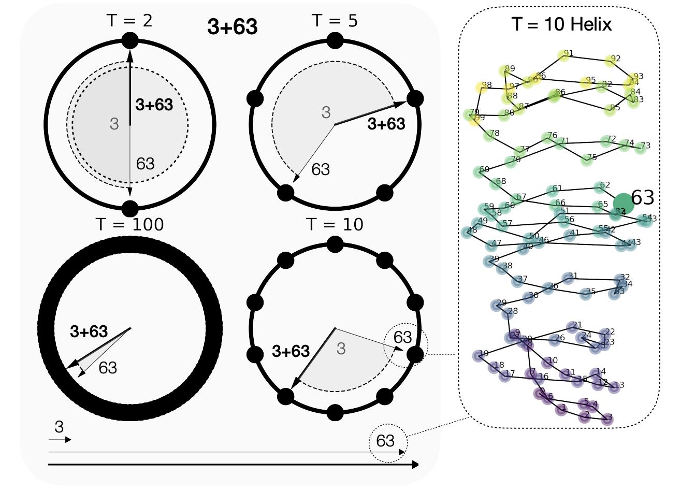
Some circuits examples
modular addition
a + b =
1. embed a and b on circles
[2,5,10,100]
2. sum them on circles
3. read back to logits

Slide 49
Some circuits examples
indirect object identification (IOI)
fact localisation

Slide 50
Thanks for your attention :)

Slide 51
materials
https://transformer-circuits.pub/2022/toy_model/index.html
https://www.lesswrong.com/posts/TvrfY4c9eaGLeyDkE/induction-heads-illustrated
https://transformer-circuits.pub/2024/scaling-monosemanticity/index.html
https://arxiv.org/abs/2502.00873
https://transformer-circuits.pub/2021/framework/index.html

